Slide 1


Nile Customer Support Dashboard Overview & Discussion

Slide 2
Agendas
1. Customer Sentiment Analysis
2. Root Cause Analysis
3. Service Response Time Analysis
4. Customer Segmentation
5. Trends and Patterns Identification

Slide 3
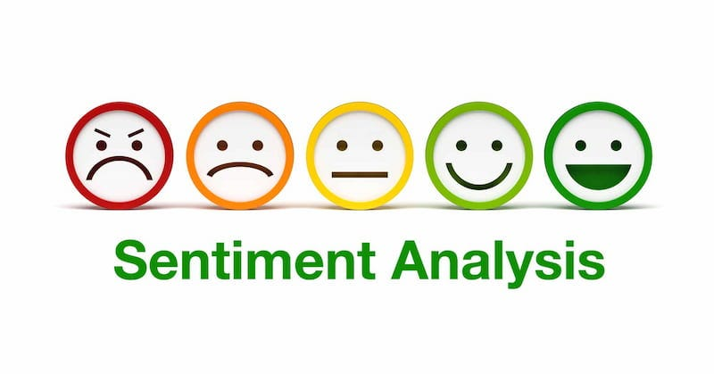
Customer Sentiment Analysis
This section analyzes customer sentiment from various sources. We see the overall sentiment, identify channels with specific feedback patterns, and track sentiment trends over time, helping us understand customer satisfaction and target improvement efforts.
We have observed that highest customer sentiment was negative which is not good and we have to work on to convert it to positive & very positive in coming quarter.
During our analysis we got to know most of the customer is facing issue with billing related due to which sentiment of the customer might be negative we can train our staffs more on this specific issue as it will help them to resolve this of customer at the earliest also inform the accounts team about this issue.

Slide 4

Root Cause Analysis
We have identified the most common issues facing by customers for which we have received most of the queries from them is billing related issue.
We can work on priority to resolve billing related issue at the earliest also inform the accounts team to check if there is something we can do to reduce the billing related issue facing by customers.
As the number of billing related queries decreases it might help convert the sentiment of customer from negative to positive, We should also keep monitoring other issue also to improve overall customer sentiment to very positive.

Slide 5
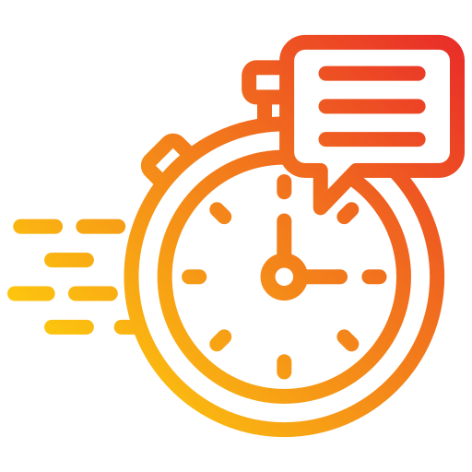
Service Response Time Analysis
This section focuses on service response times. We have observed that most of the time we have maintained to resolve customer queries within or below SLA.
Although we have maintained to resolve the customer queries within or below SLA still it would be better if we work on to resolve more customer queries within or below SLA so that we can reduce the above SLA percentage which is now at 13%.
It will help us to improve customer satisfaction and customer sentiment will also increase.

Slide 6
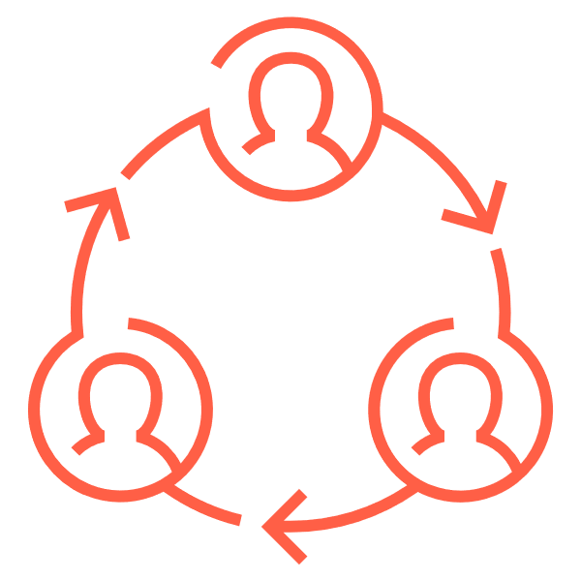
Customer Segmentation Analysis
Across the channel and call-centers locations we have received a total of 32941 customer queries.
In our analysis we observed that most of the work volume we have received is at the Los Angeles/CA and Baltimore/MD call-center location. Where Los Angeles/CA received 13734 number of customer queries and Baltimore/MD received 11012 number of customer queries.
We should prioritize to improve the service of this two location as we receive highest work volume at this locations. We can increase the staff capacity and give refresher trainers to existing staffs which will help us to improve our service to the customers and resolve more customer queries.
Call-Center Location | Volume
Los Angeles/CA | 13734
Baltimore/MD | 11012
Chicago/IL | 5419
Denver/CO | 2776
Total | 32941

Slide 7

Trends and Patterns Identification
We have observed the trend in work volume and seen that the work volume starts increasing after the 1st week o the month.
We can prepare our staff to improve the process to resolve the customer queries on time even if the work volume gets increased.
As mentioned earlier we should give more preference to the call-center location where we received highest work volume to improve the quality of service given to customer, time taken to resolve customer queries and preparing the staffs with refresher trainings on the process and increasing staff if needed.
This changes will help us to achieve give better service to the customers and improve the sentiment of customer.

Slide 8

Conclusion
Customer Support dashboard provides valuable insights into various aspects of your customers. By analyzing customer sentiment, root causes, response times, customer segmentation, trends and patterns we can make data-driven decisions to improve customer satisfaction, loyalty, and overall experience. Remember ongoing monitoring and analysis using this dashboard are crucial for continuous improvement and adaptation to evolving customer needs.

Slide 9
Thank you

Slide 10
